Slide 1

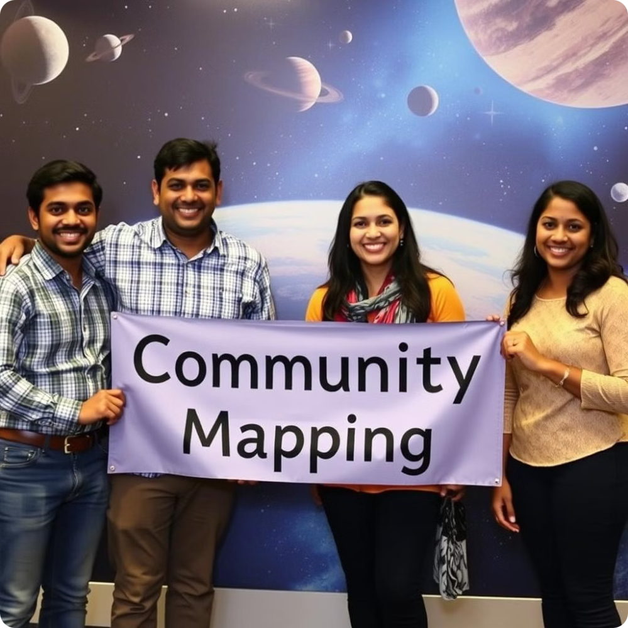
Community Mapping.
AstroGIS TRIO (Technology-driven Remote sensing Innovators in Orthomapping)
Introducing our members:
Siddhant Srivastava
Shreya Mishra
Shrutika Santosh Mahandule
Arun Satish Kumar

Slide 2
Project Overview
What we developed:
Main Components:
A data-driven tool that analyzes and visualizes traffic congestion patterns in Bengaluru, combining open-source traffic data.
Traffic data analysis
Visualization of congestion, road utilization, and environmental impact

Slide 3
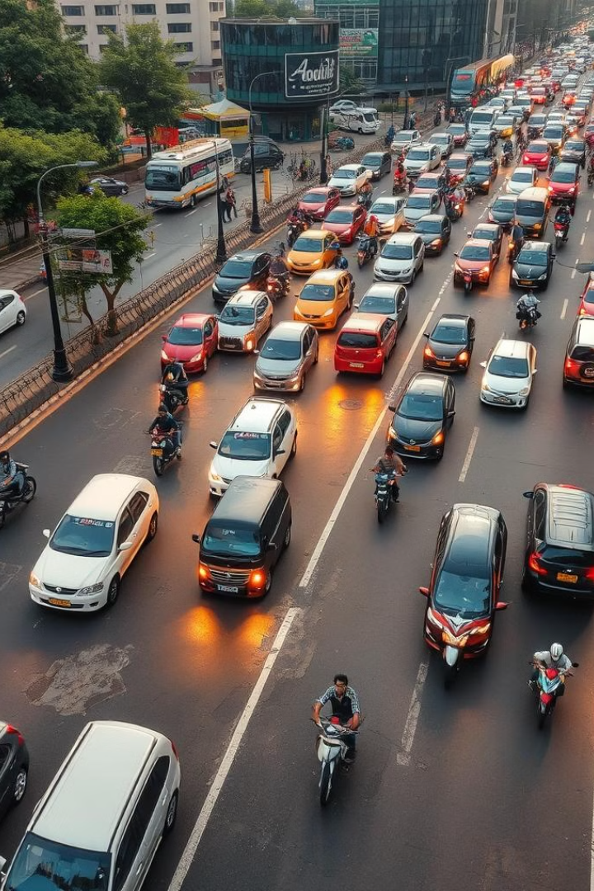
The Problem
1
Traffic Congestion in Bengaluru:
Rapid urbanization has led to high congestion levels, impacting daily commutes, air quality, and overall quality of life.
2
Challenge Goals:
Use open-source data to explore how traffic issues are shaped by Bengaluru’s physical geography and urban layout.

Slide 4

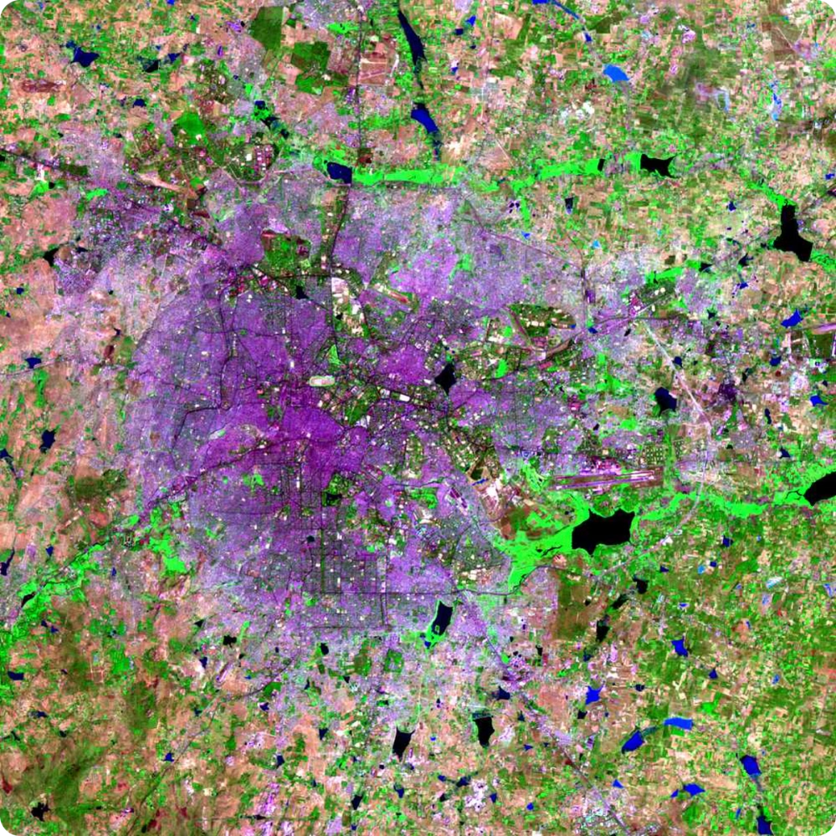
Solution Approach
1
Data Analysis: We analyzed traffic volume, congestion levels, average speed, and pedestrian/cyclist counts using Python tools (Pandas, Matplotlib, Seaborn).
2
Tools & Technologies:
Python and R Studios (data analysis)
Tableau (Dashboard and Data Visualization)
SQL (Database)

Slide 5

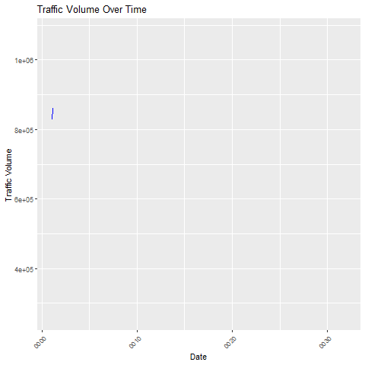
Key Insights & Visualizations
Traffic Volume Trends: Time-series plots revealed peak congestion periods across different areas.

Slide 6

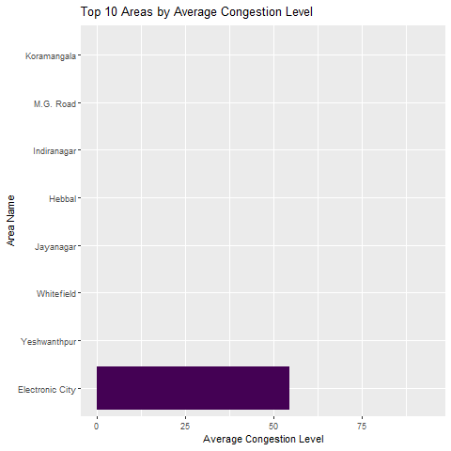
2. Congestion Levels by Area: Identified the top areas with the highest congestion levels using bar plots and GIS maps.

Slide 7

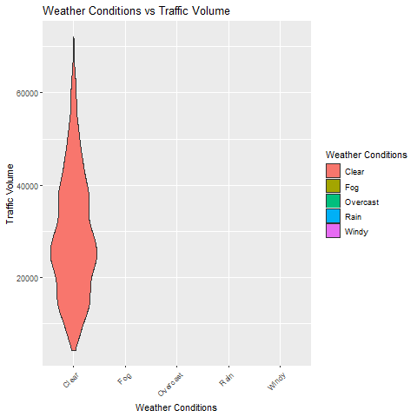
3. Weather Impact on Traffic: Violin plots showed how weather conditions influence traffic volume.

Slide 8

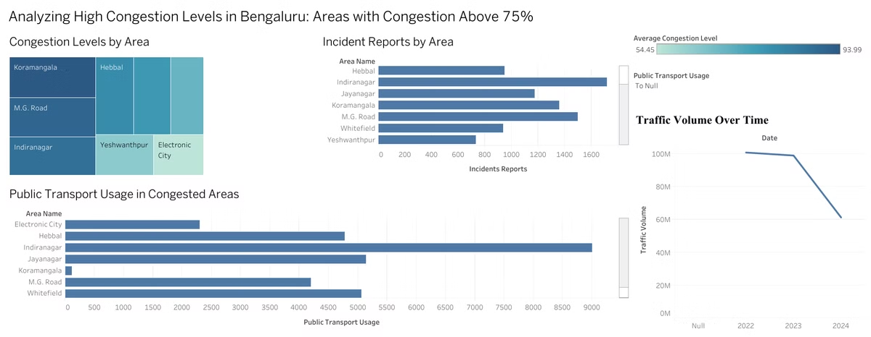
Dashboard for Analyzing Congestion Level

Slide 9



Benefits of Our Solution
Actionable Insights for urban planners and traffic authorities to improve road infrastructure and optimize traffic flow.
Environmental Impact: Helps reduce congestion and pollution by identifying key areas that need intervention.
Community Well-Being: Shorter commutes, reduced emissions, and improved traffic management lead to a better quality of life for Bengaluru’s residents.

Slide 10


Conclusion & Next Steps Urban Planning
Conclusion: GeoTraffic Insights offers a holistic view of Bengaluru's traffic challenges, merging data and geography to uncover critical patterns and provide solutions.
Next Steps:
Expand the model to include real-time traffic data.
Collaborate with city planners to implement data-driven improvements.

Slide 11
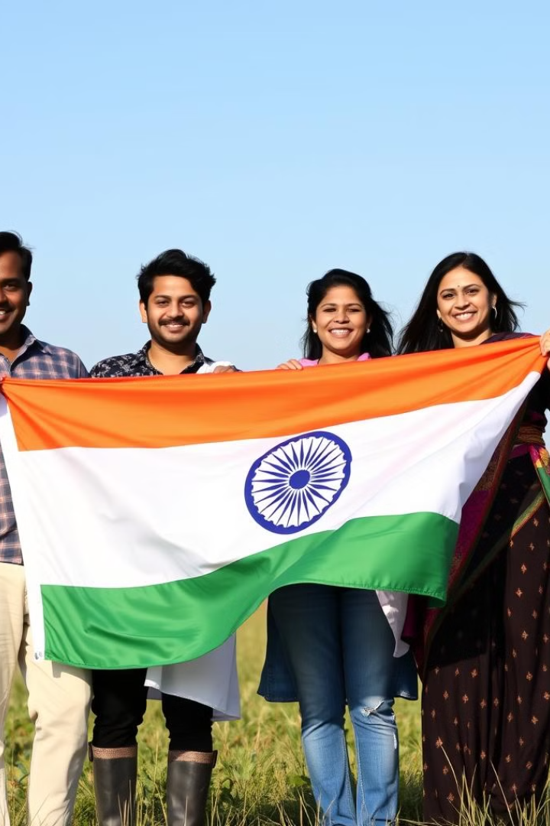
Thank You

